Slide 1


Wise Words
A Commitment for Life Service of Worship

Slide 2
Call to Worship
Leader: Wisdom calls aloud in the street; she raises her voice in the public square.
All: We come to listen for God’s wise words.
Leader: Out of God’s bounty, the earth brings forth its harvest.
All: We come to give thanks with joy.
Leader: Across the world, our siblings cry out for justice.
All: We come with open hearts and outstretched hands.
Leader: The fear of the Lord is the beginning of wisdom.
All: Blessed be God, Source of all wisdom, now and forever. Amen.

Slide 3
Opening Hymn
“Come, ye thankful people, come”
(Rejoice and Sing 274; MP 92)

Slide 4
Opening Prayer
In the name of Jesus, the Word made flesh, who taught us to pray…
Our Father in heaven, hallowed be your name. Your kingdom come, your will be done, on earth as in heaven. Give us today our daily bread. Forgive us our debts as we forgive those in debt to us. Lead us not into temptation but deliver us from evil. For the kingdom, the power, and the glory are yours, now and for ever.
Amen.

Slide 5
Introduction to Service theme: Wise Words

Slide 6
Second Hymn
“For the beauty of the earth”
Rejoice and Sing 31; MP 201.

Slide 7
First Reading: Proverbs 1:20–23, 33

Slide 8
Gospel Reading: Matthew 7:24–27

Slide 9

Prayers of Confession
Forgive us, Lord…
All: Teach us your wisdom.
Be at peace, and walk in wisdom.
All: Thanks be to God.
Amen.

Slide 10
Third Hymn
Make me a channel of your peace”
Rejoice and Sing 663; MP 438

Slide 11
Sermon: Wise Words

Slide 12
Intercessory Prayers
Lord…
All: Graciously hear us. *

Slide 13
Closing Hymn
Lord of the harvest, hear”
Rejoice and Sing 531

Slide 14
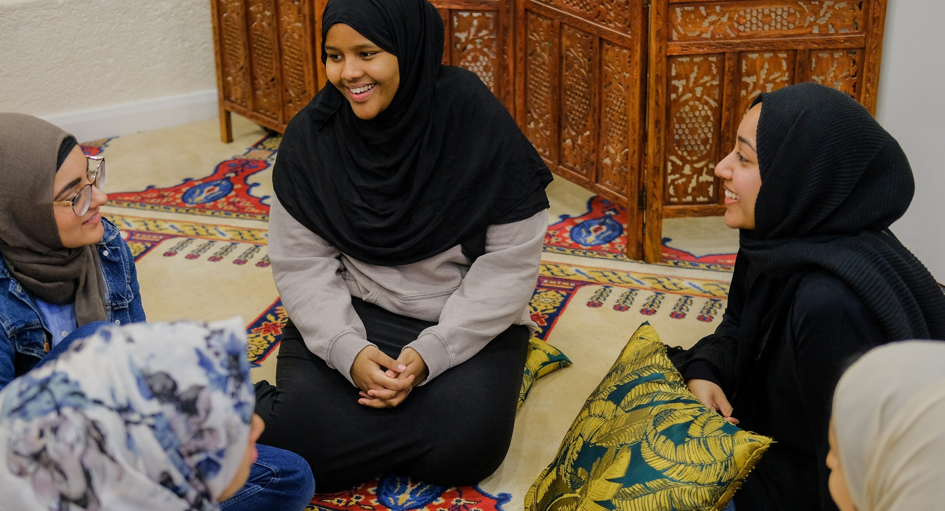
Benediction

