Slide 1

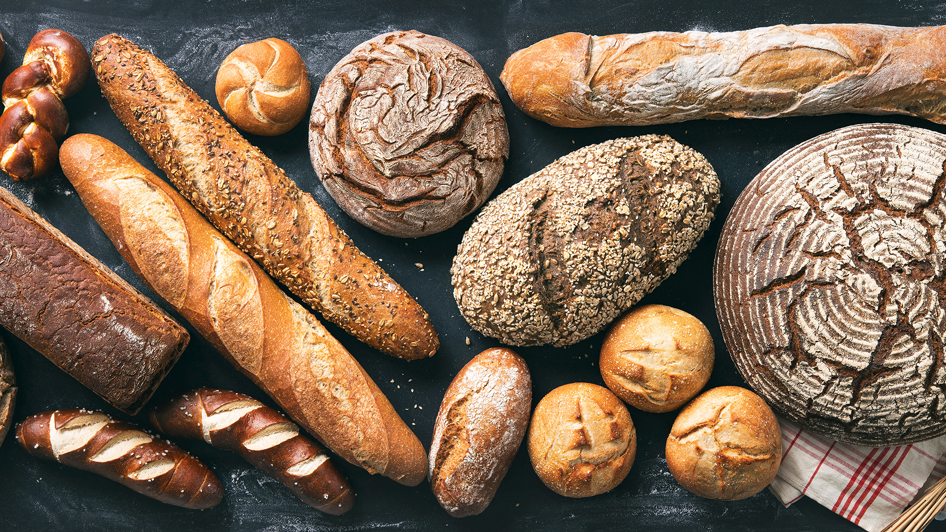

A Commitment for Life Service of Worship
Harvesting Hope

Slide 2
Call to Worship
Leader: Come, people of God, bring your harvest of hope!
All: We come to worship the God of abundance.
Leader: Come with hands ready to work and hearts open to justice.
All: Receiving from our God whose justice rains into streams of living water.

Slide 3
Call to Worship
Leader: Come with thanksgiving for what the earth yields, with longing for a world where all are fed.
All: Glory to God whose mercy grows like a mighty tree, whose hope is harvested in joy!

Slide 4
Hymn 1: R&S 41 For the Fruits of All Creation

Slide 5
Prayers of Approach
Creator God,
You are the source of every good gift—sunshine, rainfall, seed and soil, strength, and community. We praise you for the changing seasons, for fields that whisper your faithfulness, and for the call to share the harvest with joy.

Slide 6
Prayers of Approach
At this Harvest time, we come with thanksgiving— not only for what we have received, but for the hope we are called to plant: hope that justice will take root, that the hungry will be fed, that the exploited will be free, and that the earth will be healed.

Slide 7
Prayers of Approach
Make our worship be fruitful today, O God, as you prepare us as labourers for love in your harvest of hope.
Amen.

Slide 8
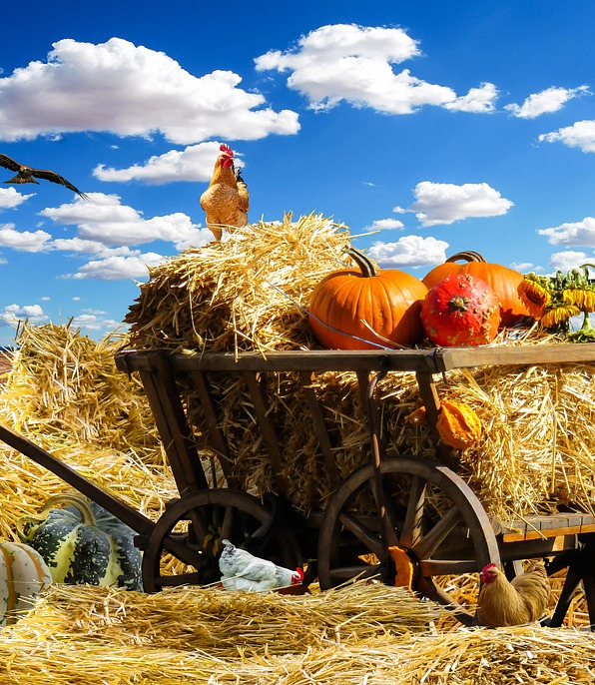
Theme Introduction: "Harvesting Hope"

Slide 9
Hymn 2: R&S 582 “O Day of God, Draw Nigh”

Slide 10

Prayers of Confession and Assurance

Slide 11
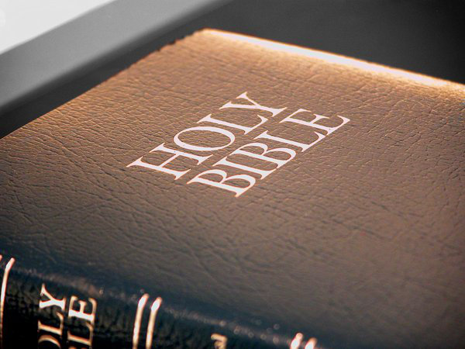
Bible Reading 1
Amos 9:13–15
This Photo by Unknown Author is licensed under CC BY-SA

Slide 12
Bible Reading 2
Luke 4:16–21
This Photo by Unknown Author is licensed under CC BY-SA

Slide 13
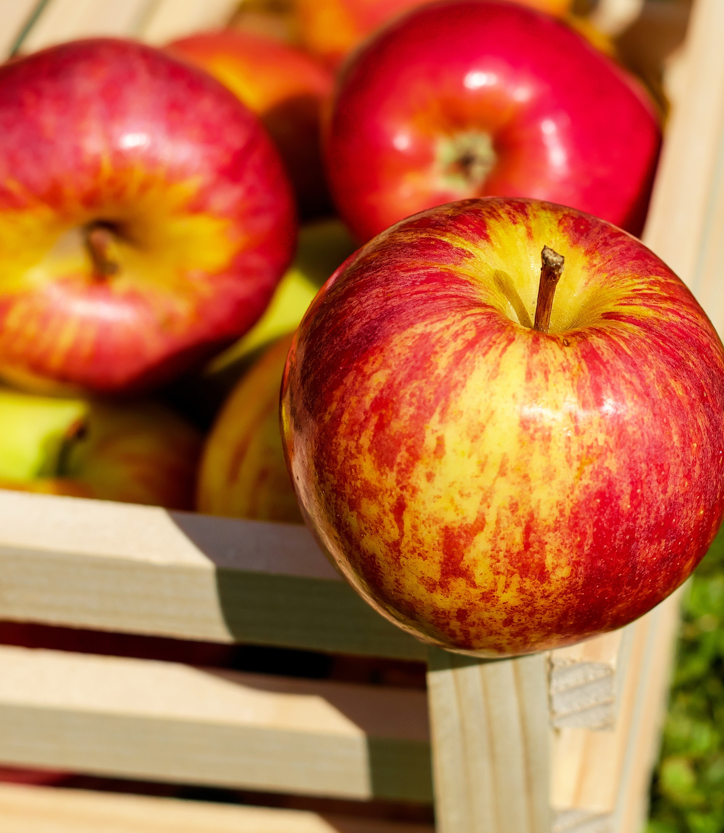
Sermon Harvesting Hope

Slide 14

Prayers of Intercession
Response: Lord of the harvest
Bring your justice and peace.

Slide 15
Hymn 4: R&S 90 “Come, You Thankful People, Come”

Slide 16

Benediction & Grace
…And may the grace of our Lord Jesus Christ, the love of God, and the fellowship of the Holy Spirit be with us all, now and always. Amen.

