Slide 1
CLR Comms (Webpage)

Slide 2
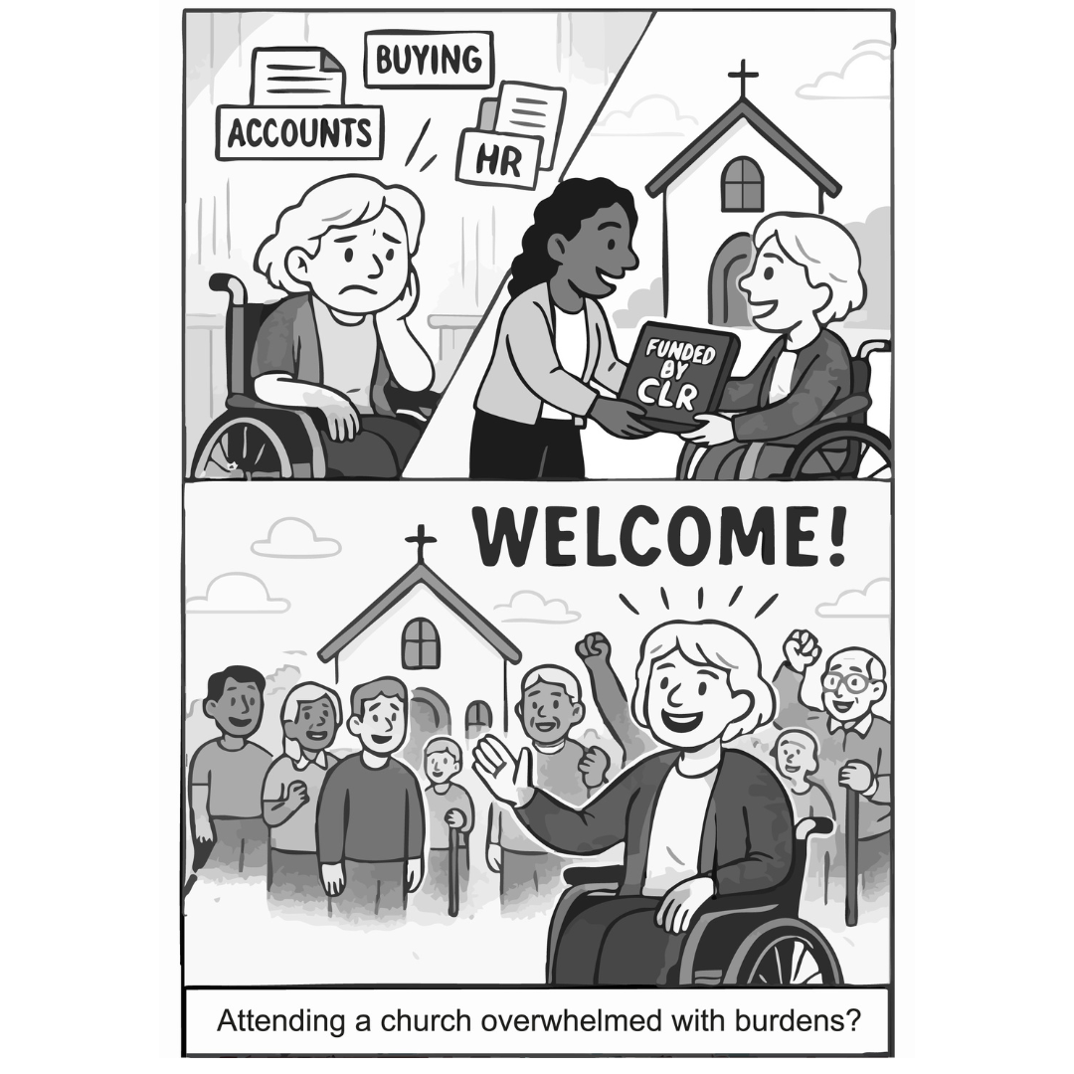
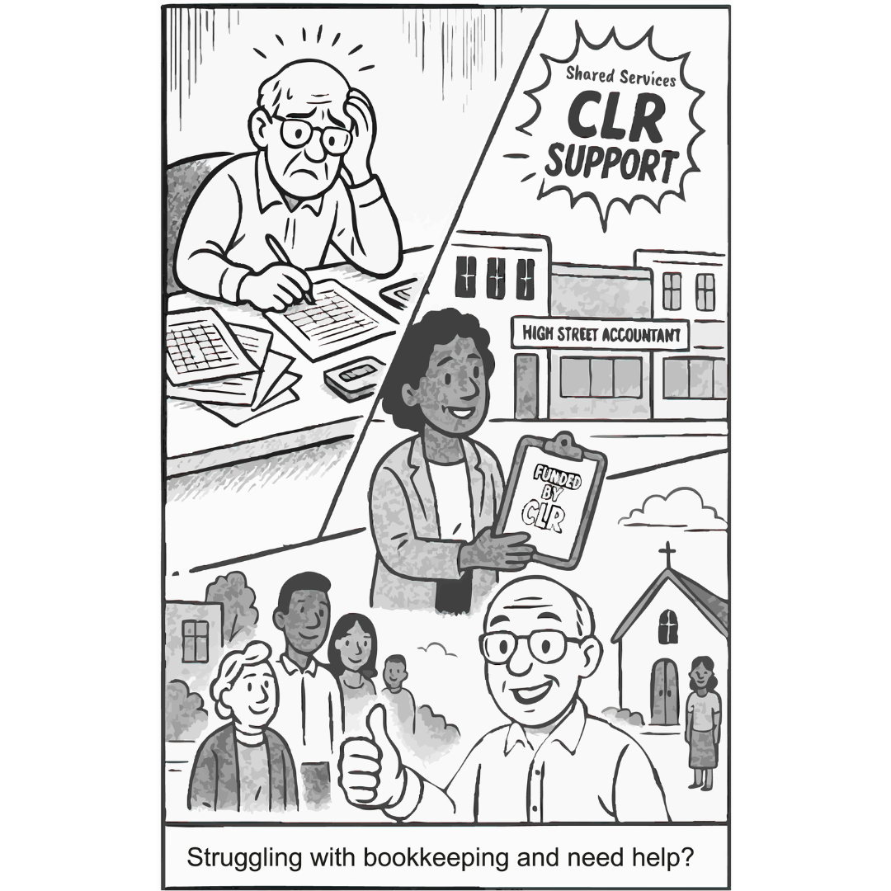
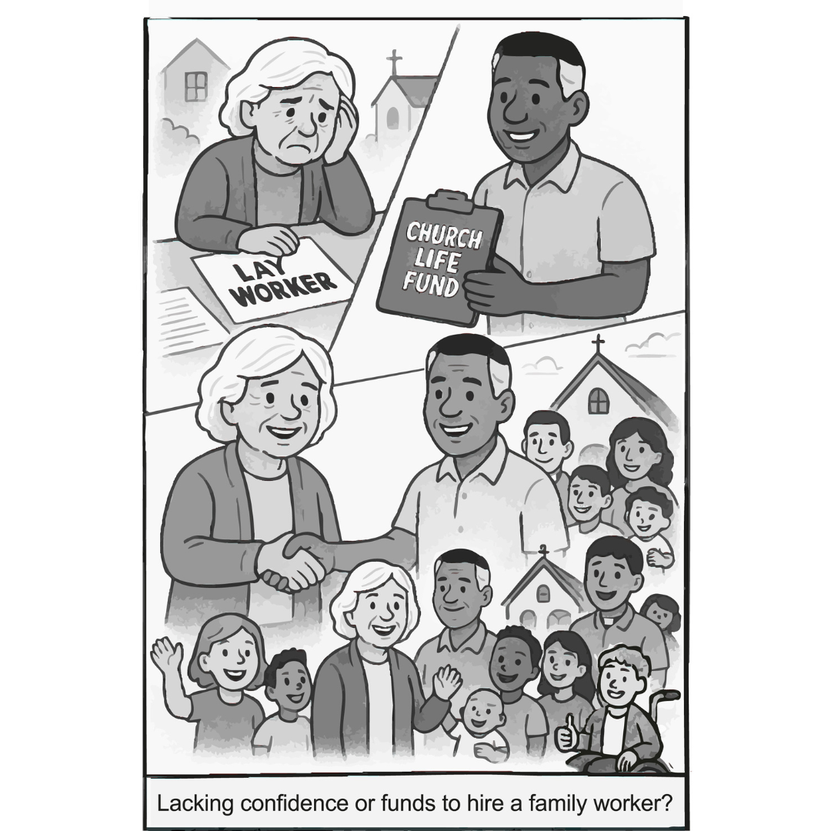

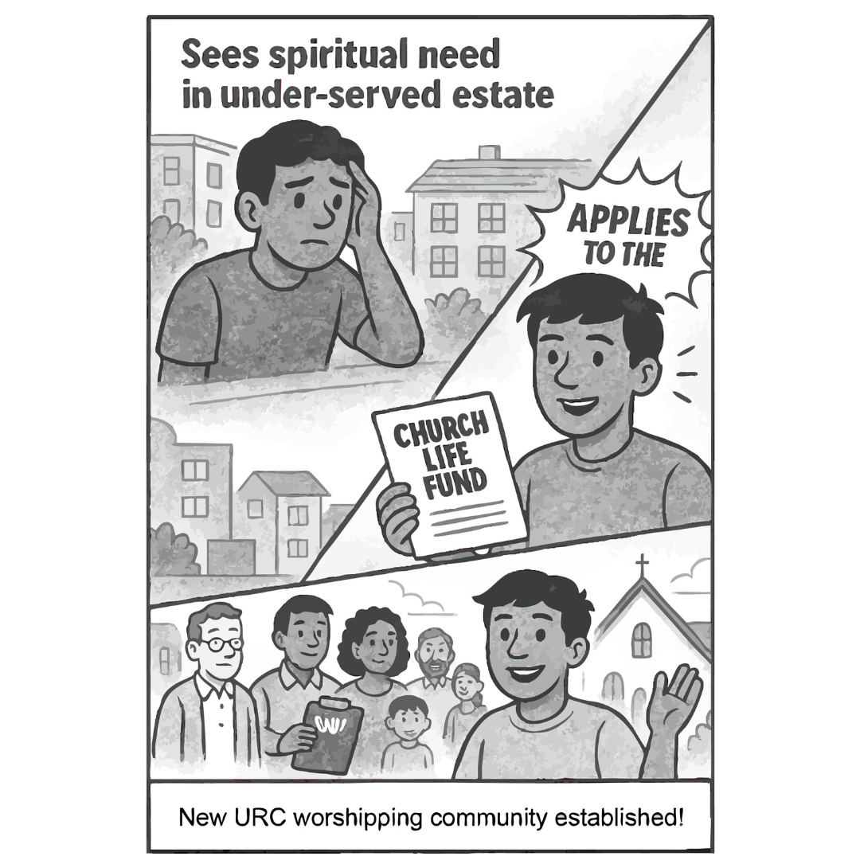
Link to location: https://urc.org.uk/church-life-review-group/
Feeling overwhelmed by everything church life requires—HR, admin, and finances? The CLR aims to lighten the load by proposing shared services and support, so your church can focus on mission, not paperwork.
Managing church finances can be overwhelming. The Church Life Review proposes a Shared Services Hub to take the pressure off local treasurers and administrators—offering expert support and tools that make a real difference.
Want to support ministry but lack the confidence or funding? The proposed Church Life Fund could help congregations like yours hire family, youth, or lay workers—making local mission and care more achievable.
Not sure where to begin with admin tasks like HR forms or letting your church hall?
The Church Life Review proposes a Shared Resource Hub to offer practical support with the everyday responsibilities that can weigh down local churches—so you’re not left to figure it out alone.
See spiritual need in your community but unsure how to respond? The Church Life Review proposes a shared fund to support new URC worshipping communities, especially in underserved areas.

