Slide 1
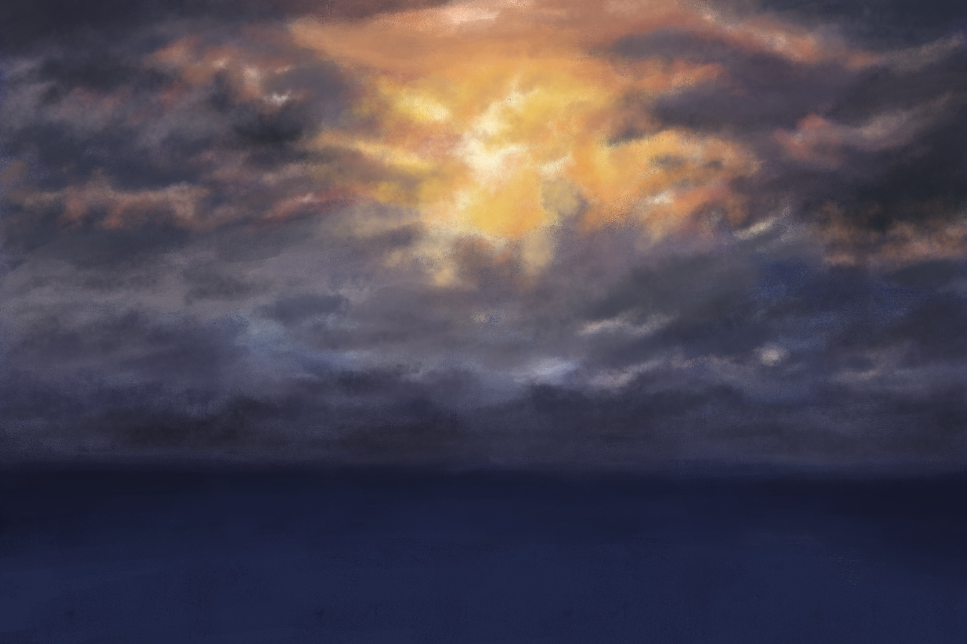
What do we treasure?

Slide 2
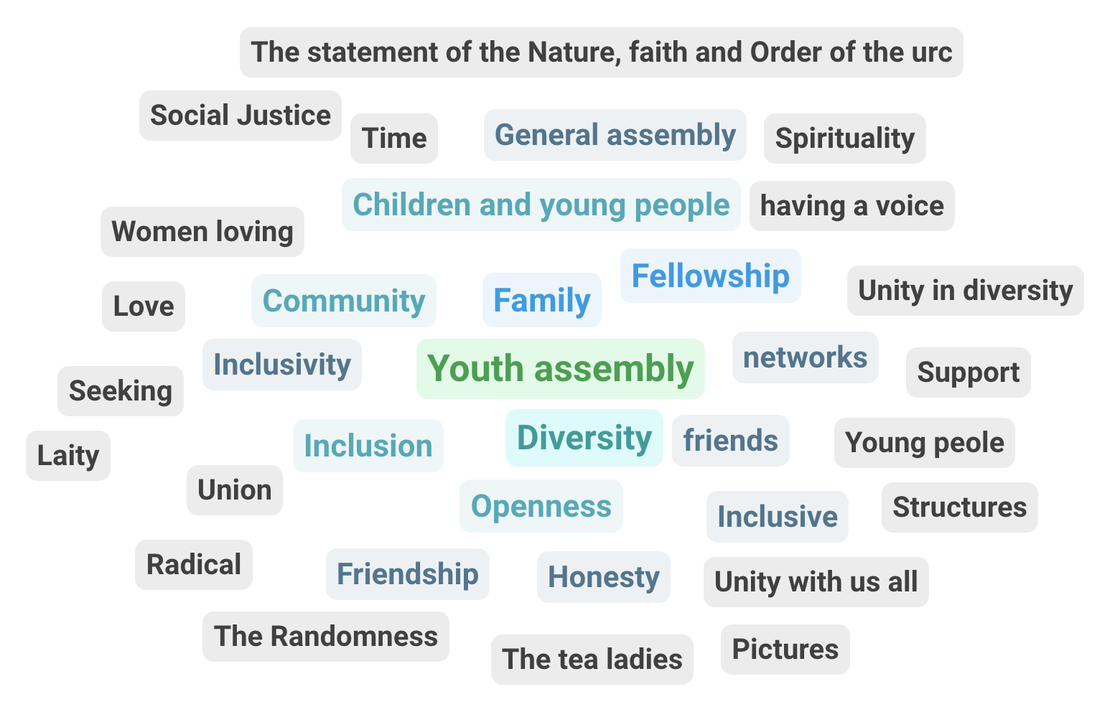

Slide 3
What is working?

Slide 5
What needs shaking?

Slide 7
To which NEW THING. might God be calling?

Slide 9
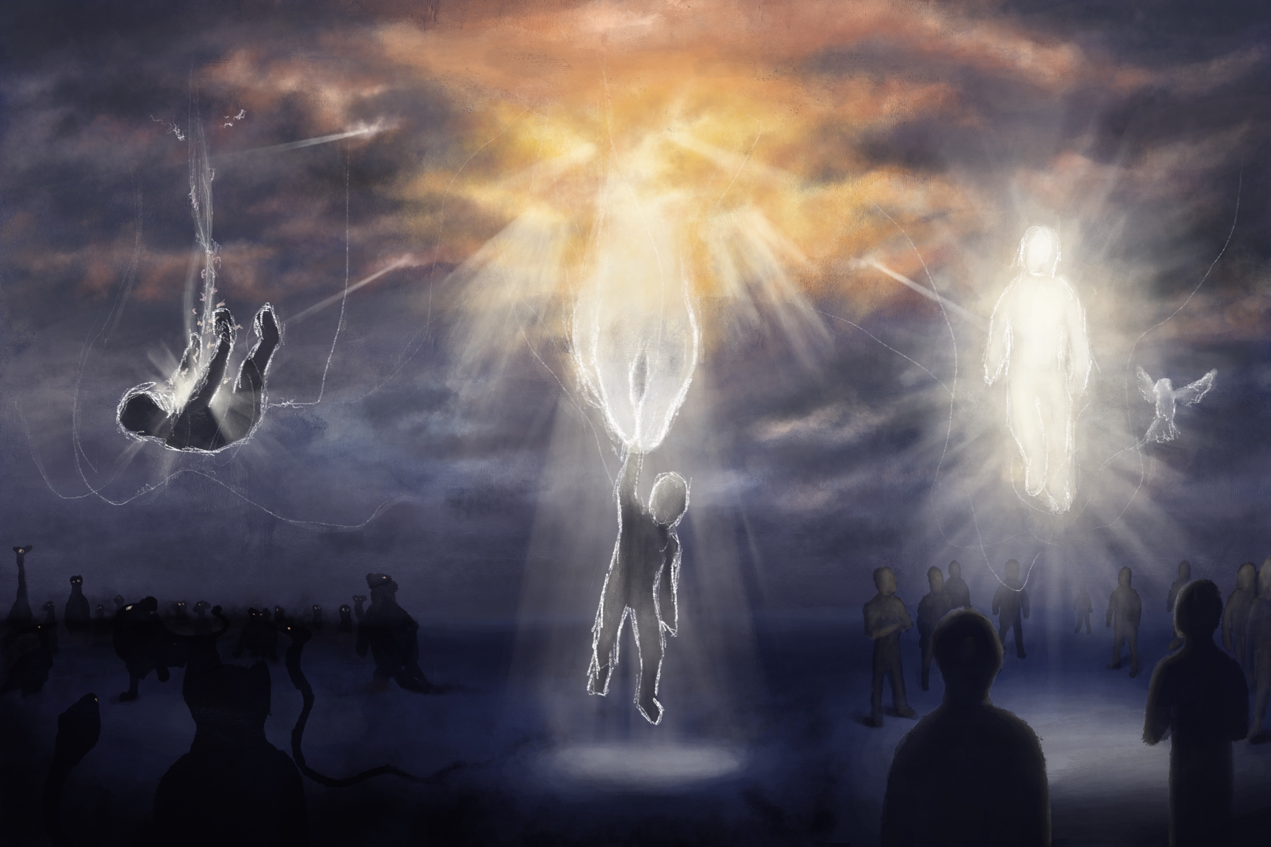
‘No more cycles’
Image by Tariq Westcarr

