Slide 1
This is X’s story about church

Slide 2
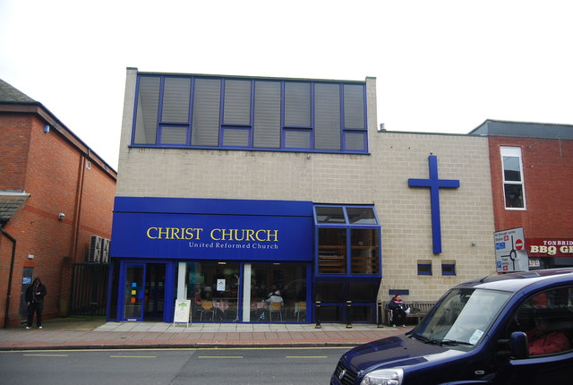
Here is X’s church. It is called XXXXXXXXX

Slide 3
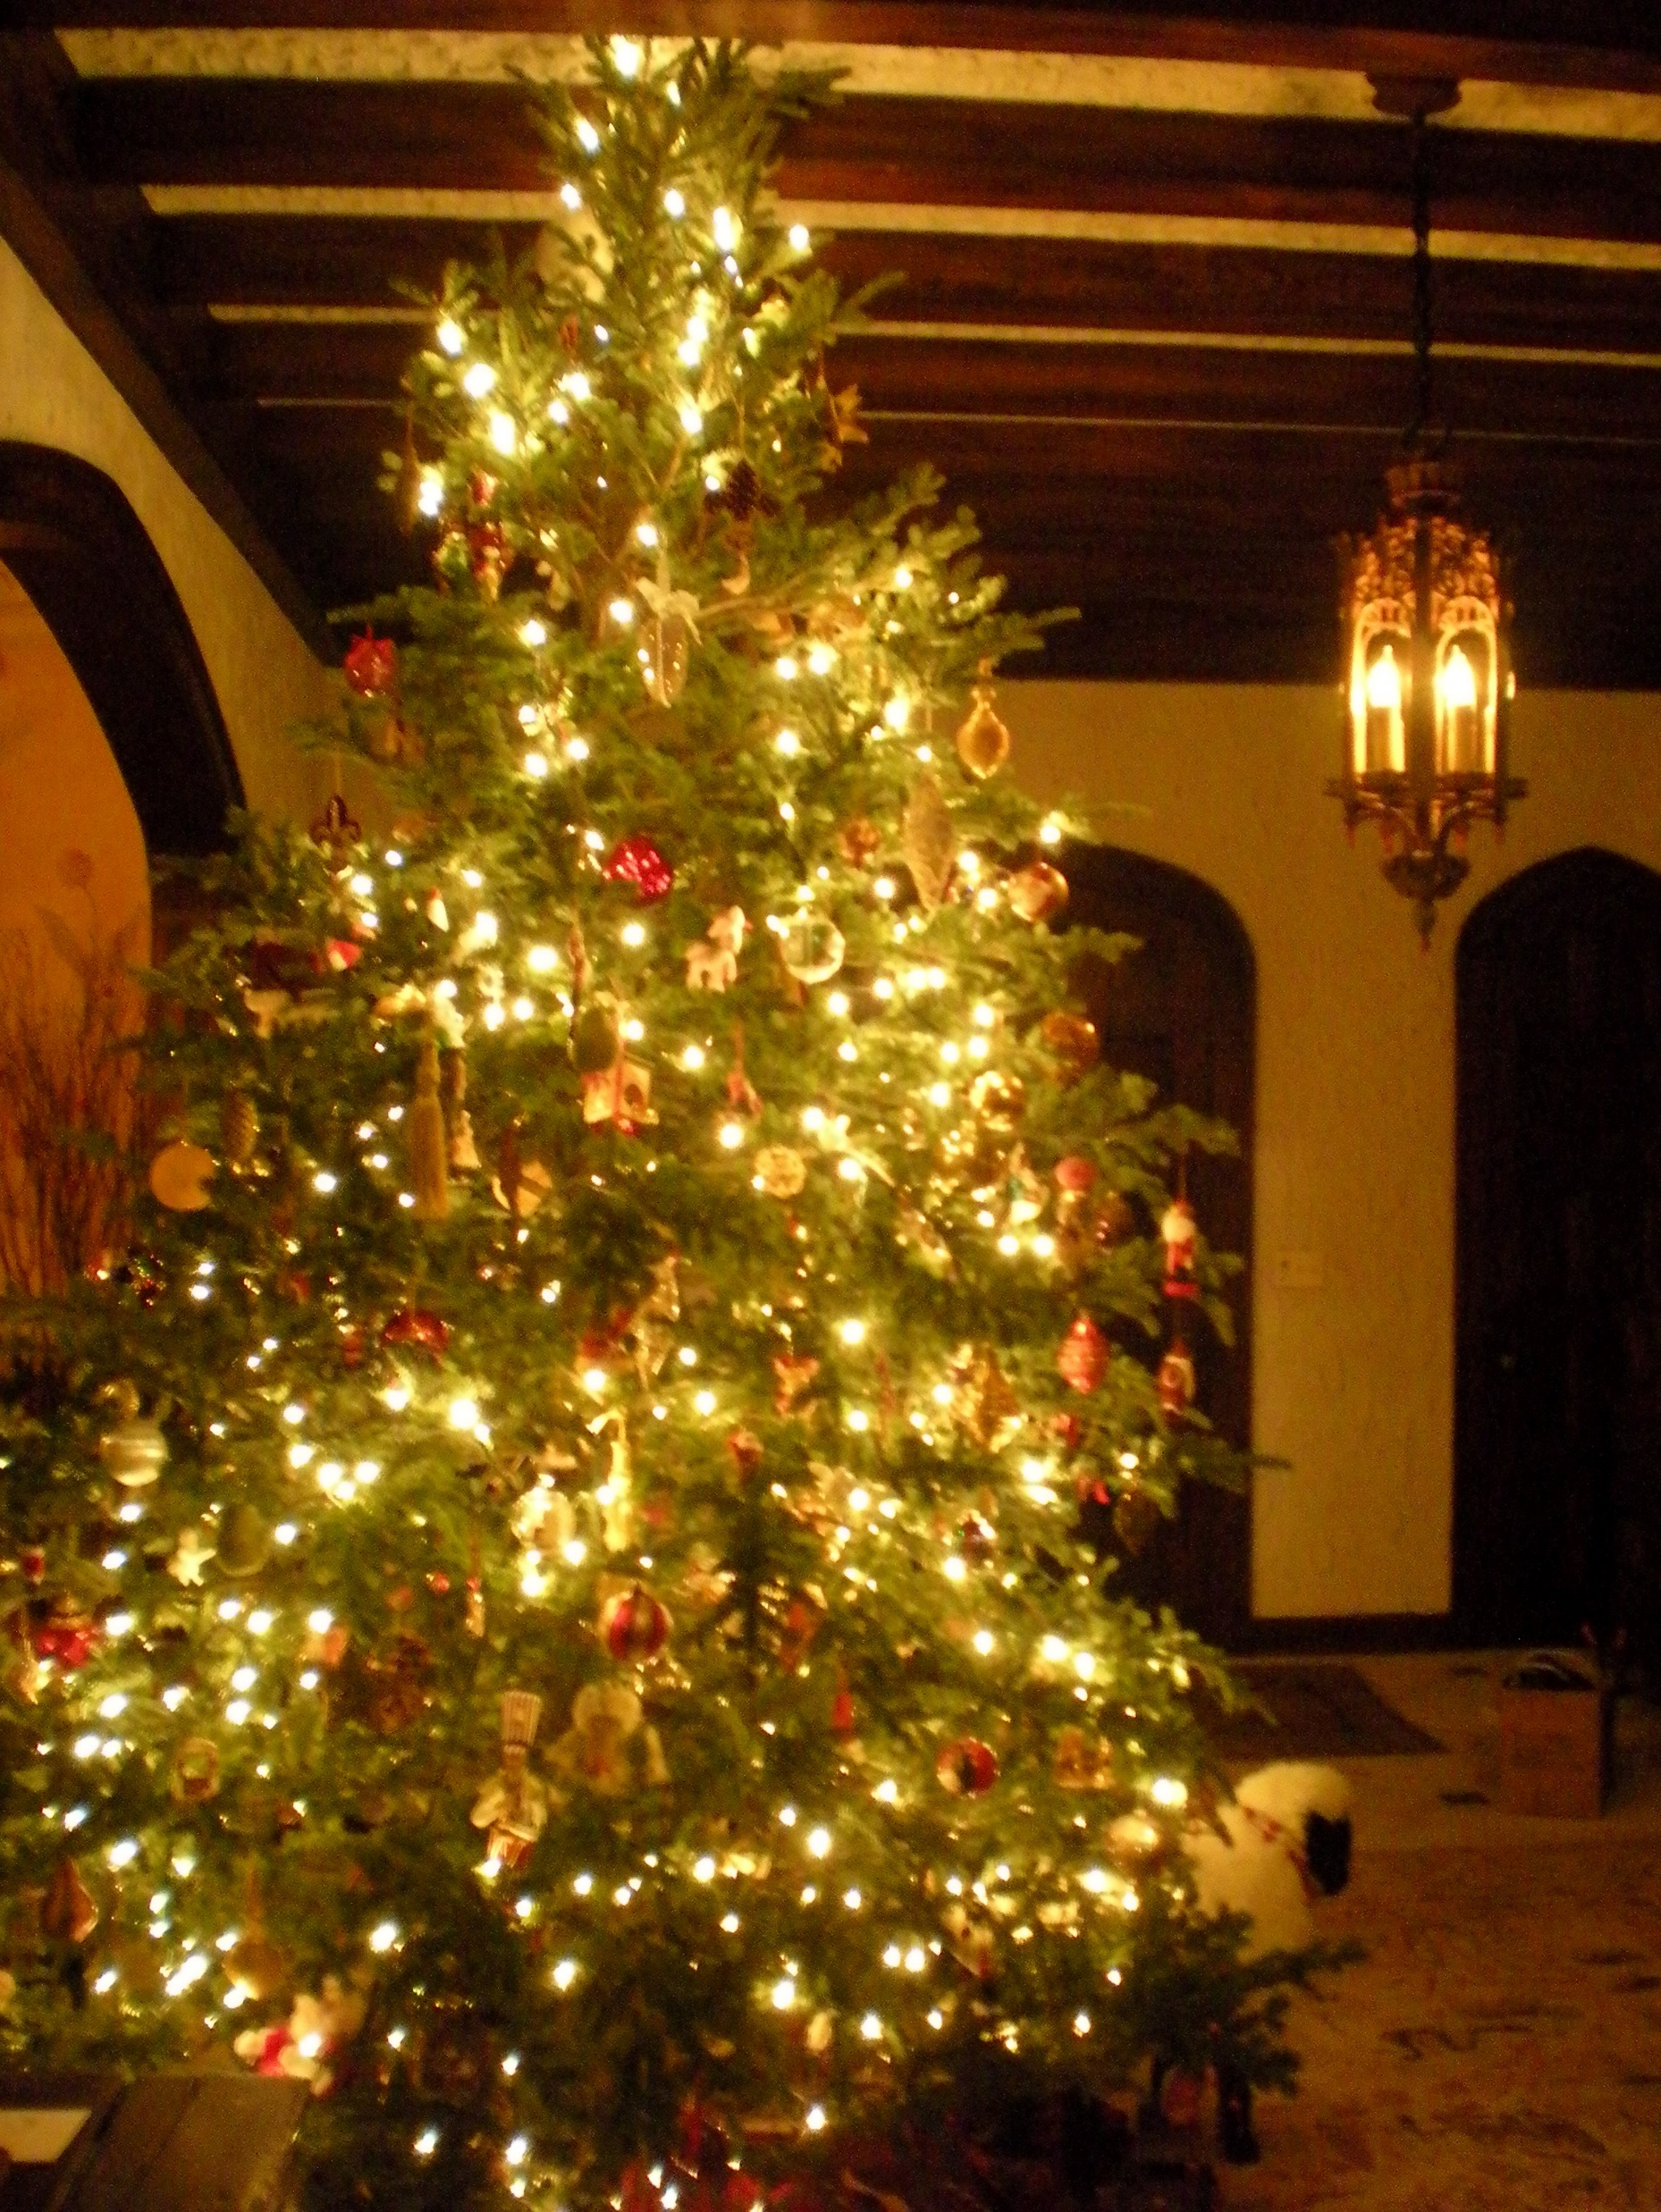
At Christmas the inside of the church will look different. There will be a Christmas tree with lights and tinsel.

Slide 4
The lights will be on but will not flash.

Slide 5
There might be more people in church at Christmas.

Slide 6
Some people might bring presents to show

Slide 7
X can choose to show a present or can choose not to show a present. X can say ‘no thank you’.

Slide 8
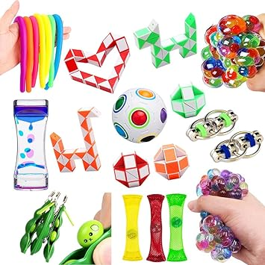
This Photo by Unknown Author is licensed under CC BY-NC-ND
If X needs a break, X can play with a fiddle toy

Slide 9
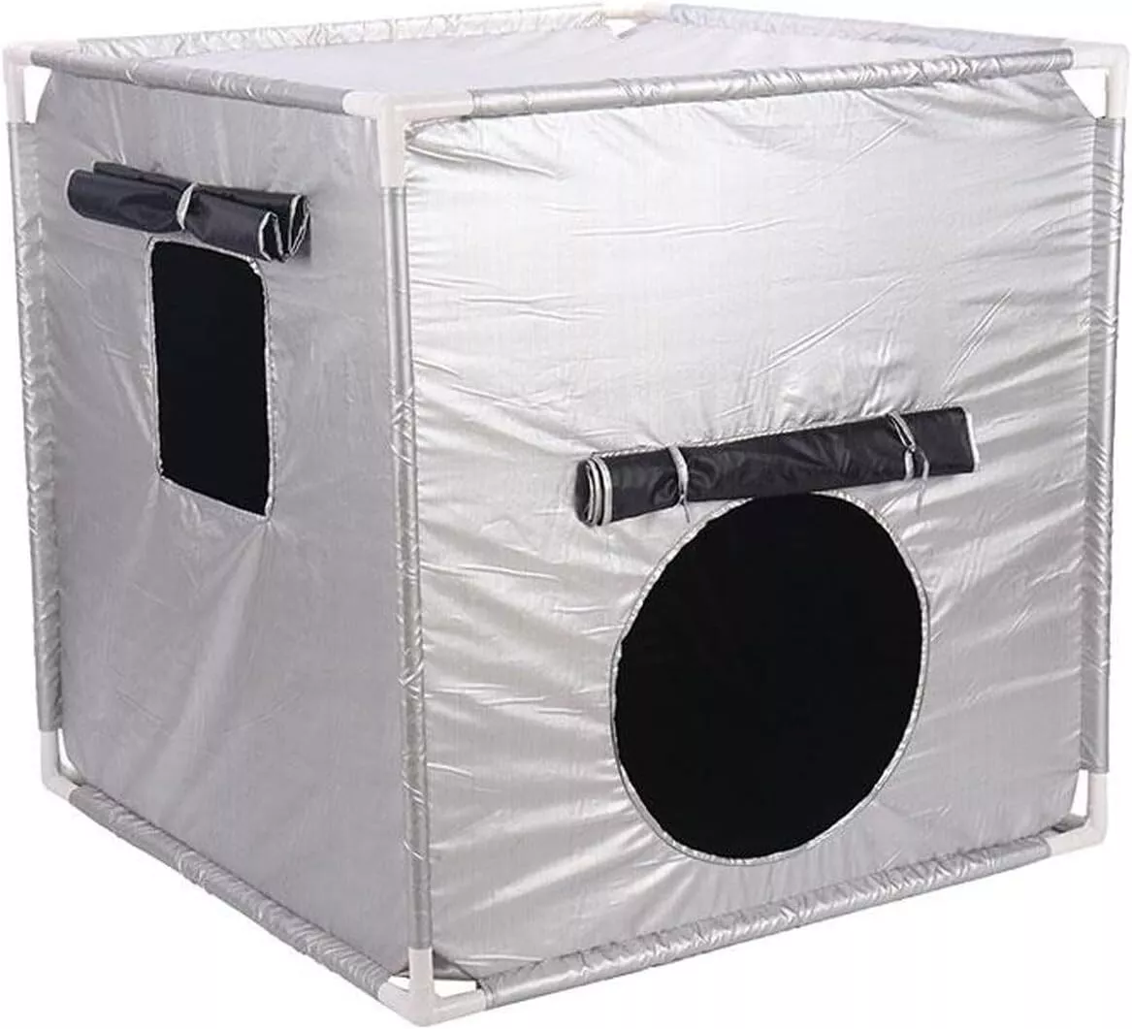
If X needs a break, X can sit in the dark tent in church

Slide 10
If the music or talking is too loud, X can wear their ear defenders

Slide 11
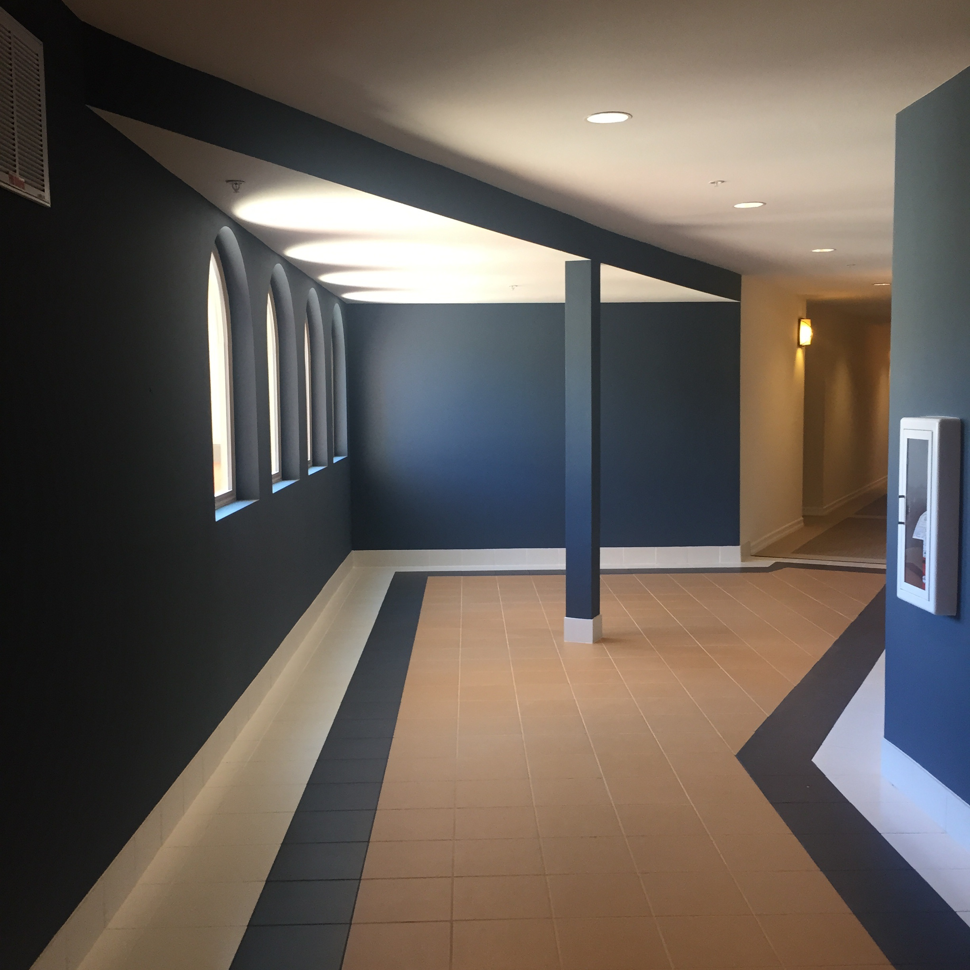
X can ask to sit in the junior church room for a while with an adult

Slide 12
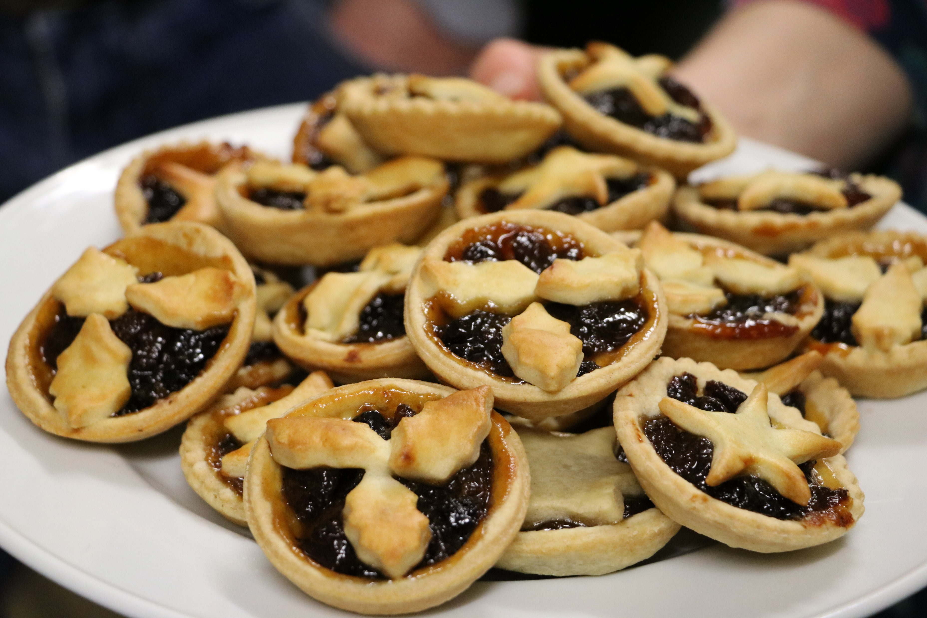
After the service there will be drinks and mince pies.

Slide 13
Then X can say goodbye and go home with mum and dad

Slide 14
After Christmas, X’s church will go back to normal.

